Slide 1
Serum concentration Tests
Author
Institutional Affiliation
Instructor
Course code
Date of submission

Slide 2
Introduction
Vitamin B-12 represents one of the essential components responsible for efficient brain health, proper nerve functioning, and the production of blood cells.
Vitamin D is also another important nutrient that is essential for healthy bones and teeth.
Ensuring a healthy balance of these essential vitamins in the bloodstream is usually essential for maintaining good health.
Because of this, lab tests for nutritional content are usually important to help individuals understand the current state of their health (labtestsonline, 2021).
It is essential to understand that healthcare professionals usually compare the test results against a reference range of normal values to determine nutritional deficiencies.

Slide 3
Lab tests
To determine potential deficiencies of these essential blood micronutrients, healthcare professionals usually carry out vitamins blood test panels to detect deficiencies across the vitamin spectrum.
Digestive disorders may prompt healthcare providers to perform vitamin B-12 tests.
Normal levels of vitamin B-12 and vitamin D in the bloodstream indicate that an individual does not have a deficiency.
For a blood test panel, healthcare professionals usually use blood drawn from veins; however, home urine tests are also available to check the levels of these important nutrients.
A complete blood count is also recommended to evaluate suspected patients with vitamin B-12 deficiency.
From this test, any level lower than 150 pg. per mol is indicative of a deficiency.
Healthcare professionals usually use blood assays to measure the levels of vitamin D metabolites circulating in the blood (MedlinePlus, 2021).
Assays can detect total circulating 25(OH) D for both vitamin D2 and Vitamin D3 metabolites.

Slide 4
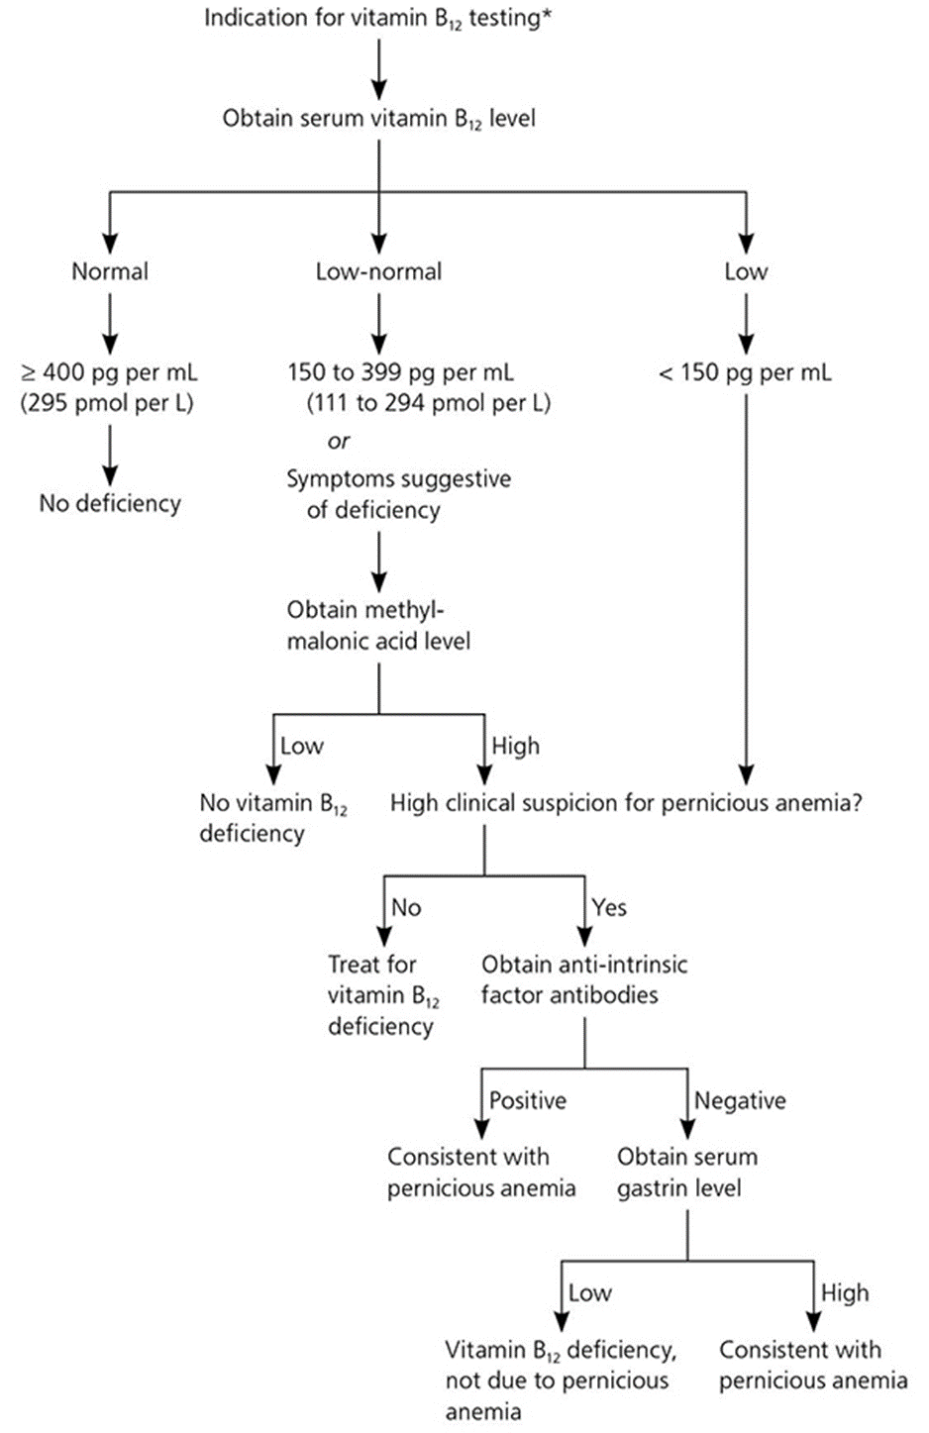

Slide 5
Understanding the results
For vitamin B-12, the normal range is usually between 200 and 900 nanograms per milliliter of blood (ng/mL).
It is essential to note that individuals whose tests show results at the lower end of this range may require additional tests to determine the underlying causes for their deficiencies.
If test results show lower levels of vitamin B-12 below 200 ng/mL, then an individual is said to have a vitamin B-12 deficiency and may at times experience neurological symptoms.
Similarly, abnormally high levels of vitamin B-12 may range over 900 ng/mL.
Arguably, such results may suggest liver or kidney problems, diabetes, or even other serious forms of leukemia.

Slide 6
Cont.….
For Vitamin D, serum concentrations of 25(OH) D are considered the best indicator of vitamin D status.
Normal levels of vitamin D in the blood, as recommended by experts, currently stand at 30 ng/ mL (the U.S. National Osteoporosis Foundation).
These levels are essential for the effective protection of bone health.
Vitamins D levels ranging between less than 12 ng/mL to 20 ng/ mL are usually considered low and may suggest vitamin D deficiency, consequently leading to rickets in infants and children.
Additionally, these considerably low levels of the essential vitamin may negatively impact general bone health.

Slide 7
Medications
Deficiencies of these essential micronutrients may affect the normal functioning of the body systems.
For vitamin B-12, regular supplementation injections may be necessary.
Supplementation considerably increases the levels of the vitamin. Besides supplementation, eating more foods rich in vitamin B-12 is also recommended.
Even though there is no upper limit for vitamin B-12 intake, increasing levels circulating in the bloodstream may be a point of concern for healthcare professionals and may suggest a severe underlying condition.
In such situations, doctors may choose to address the suspected underlying condition rather than increasing vitamin B-12 in the blood.

Slide 8
Cont.…
Treatment for vitamin B-12 particularly aims to correct either the high or low levels to reach and maintain considerably adequate levels of the vitamin in the blood.
Eating more foods rich in vitamin D is usually recommended; however, taking vitamin D supplements may be considered in extreme cases.
Elevated levels of vitamin D in the blood may damage essential organs and blood vessels.
For this reason, it is important to stop taking too much supplements and vitamin pills.

Slide 9
Plan of care
For individuals with vitamin D deficiency, treatment is recommended as follows:
For children aged between 1 to 18 years, treatment with 2000 IU/d of vitamin D3 is recommended for a period not less than six weeks.
This is essential to achieve adequate levels of 25(OH) D. Maintenance therapy for these individuals should include a 1000 IU/day therapy. For adults, a dosage of 50 000 IU is recommended for eight weeks, followed by maintenance therapy of 2000 IU/day.
Even though these are usually considered the standard treatment methods, experts recommend a higher dosage in obese patients with malabsorption syndromes ranging between 6000- 10000 IU daily followed by a 6000 IU/d therapy.

Slide 10
Cont.…
For individuals who have problems absorbing vitamin B-12, they recommend changing their diet to include vitamin B-12 fortified grains.
However, in extreme cases, vitamin B-12 injection is advised to achieve adequate blood levels of the vitamin (Langan & Goodbred, 2017).
For older adults with vitamin B-12 deficiencies, daily supplementation is advised.

Slide 11
References
Rose, A. (2021). Vitamin D testing: clinical and laboratory considerations. Retrieved 5 July 2021, from https://www.mlo-online.com/home/article/13005240/vitamin-d-testing-clinical-and-laboratory-considerations
Vitamin B-12 Level Test: Purpose, Procedure & Results. (2021). Retrieved 5 July 2021, from https://www.healthline.com/health/vitamin-b12-level
Vitamin B12 and Folate | Lab Tests Online. (2021). Retrieved 5 July 2021, from https://labtestsonline.org/tests/vitamin-b12-and-folate
Vitamin D Tests | Lab Tests Online. (2021). Retrieved 5 July 2021, from https://labtestsonline.org/tests/vitamin-d-tests
Vitamin D Test: MedlinePlus Medical Test. (2021). Retrieved 5 July 2021, from https://medlineplus.gov/lab-tests/vitamin-d-test/
Langan, R. C., & Goodbred, A. J. (2017). Vitamin B12 deficiency: recognition and management. American family physician, 96(6), 384-389.

